Slide 1
Web Application Architectures
Lecture 05

Slide 2
Categories of Web Applications
Categories of Web applications depending on their development history and their degree of complexity.
There is a correlation between the chronology of development and complexity.
Newer categories are generally more complex, but this does not mean they can fully replace the older generation.
Each category has its own specific fields of application.

Slide 3
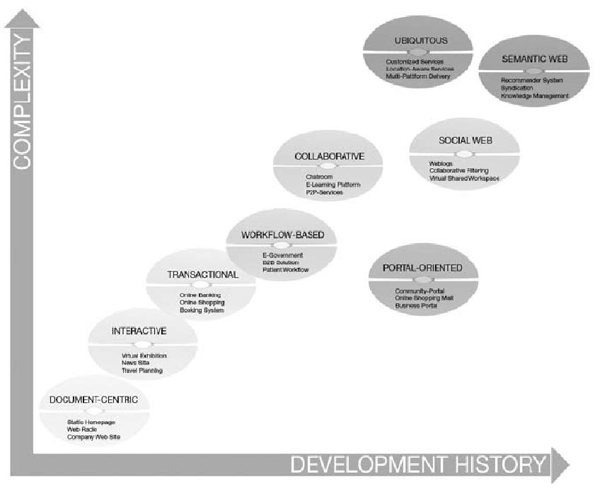
Categories of web applications

Slide 4
Characteristics of Web Applications
the reason why many concepts, methods, techniques, and tools of traditional Software Engineering have to be adapted to the needs of Web Engineering or even be totally inadequate.
Different from traditional applications, how? non-linear navigation, frequency of updates, etc.
Product-related Characteristics
major building blocks of a Web application, consisting of content, the hypertextual structure (navigational structure), and presentation (the user interface).
Content is the king, different update frequencies
Hypertext has non-linearity, Disorientation and cognitive overload problem
Presentation involves aesthetics and self explanation
Usage-related
social context (spontaneity and multiculturality), technical context (network and devices), and natural context (location and time)
Development-related
necessary resources, such as the development team and the technical infrastructure, the development process itself, and the necessary integration of already existing solutions.

Slide 5
Document Centric
Document centric Web sites are the precursor to Web applications.
Web pages are stored on a Web server as ready-made, i.e. static, HTML documents and sent to the Web client in response to a request.
These Web pages are usually updated manually using respective tools.
Especially for Web sites requiring frequent changes or for sites with huge numbers of pages this is a significant cost factor and often results in out dated information.
There is a danger of inconsistencies, as some content is frequently represented redundantly on several Web pages for easy access.
Major benefits are the simplicity and stability of such Web sites and the short response time, as the pages are already stored on the Web server.
Example are static homepages, company websites, or simple web presences for small businesses.

Slide 6
Social Web
There is an increasing trend towards a social Web, where people provide their identity to a community of others with similar interests.
Web pages serve the purpose of not only finding related objects of interest, but also finding people with similar interests.
Example are weblogs, collaborative filtering systems, and virtual shared workplace.

Slide 7
Semantic Web
Semantic Web provides a common framework that allows data to be shared and reused across application, enterprise, and community boundaries.
Current developments, especially the increasing convergence of the TIMES industry applications (Telecommunications, Information technology, Multimedia, Education and Entertainment, and Security), belongs to the semantic web.
Goal of semantic web is to present information on the Web not merely for humans, but also in a machine readable form.
Example are supply chain management, media management, knowledge management.

Slide 8
Web Application Architectures
Web architecture is the process of designing, creating and implementing an internet-based computer program.
These computer programs are websites that contain useful information for a user, and web developers design for a particular purpose, company or brand.
Web architecture involves every component of an application and helps web developers create designs that enhance a user's experience.
Ideally, a completed project allows users to access information easily and understand how to navigate its content.

Slide 9
Web Application Architectures
Poor performance, insufficient maintainability and expandability, and low availability of a Web application are often caused by an inappropriate architecture.

Slide 10
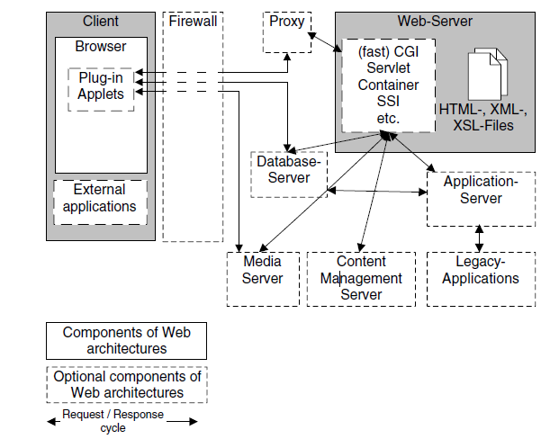
Components of a web application
Fig: Basic components of Web application architectures.

Slide 11
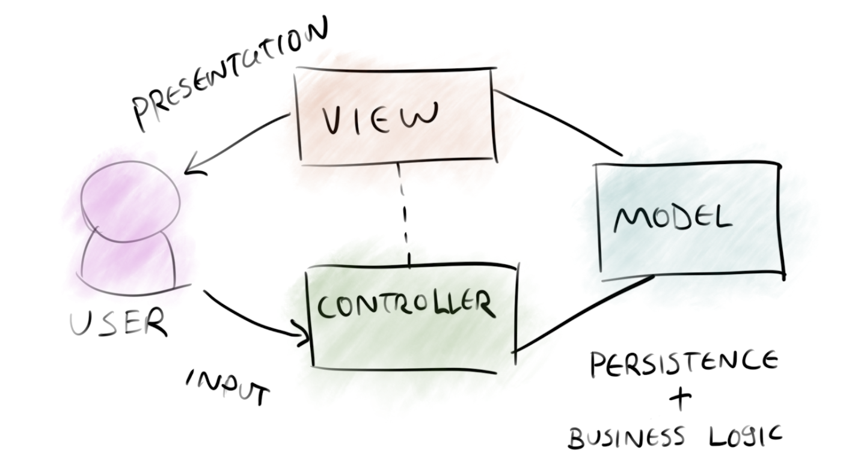
MVC Architecture

Slide 12
The model is responsible for managing the data of the application. It receives user input from the controller.
The view means presentation of the model in a particular format.
The controller responds to the user input and performs interactions on the data model objects. The controller receives the input, optionally validates it and then passes the input to the model.

Slide 13
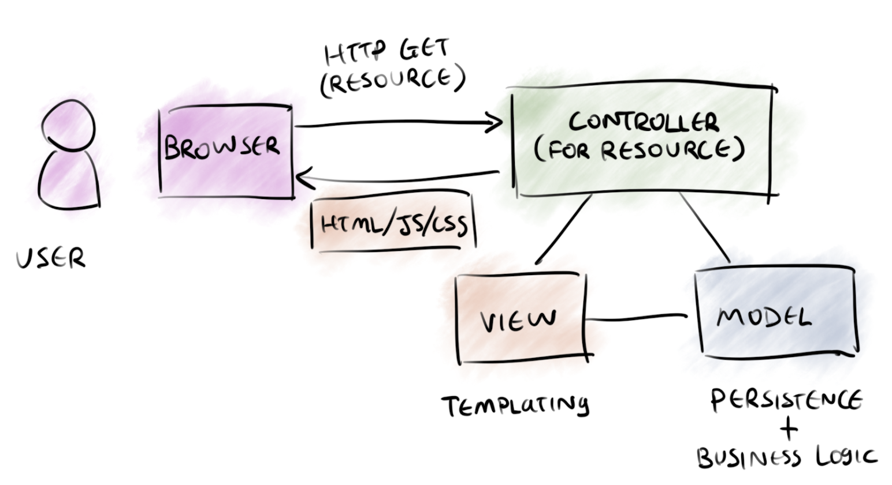
Web MVC

Slide 14
Uses for Web
Several web frameworks have been created that enforce the MVC pattern.
These software frameworks vary in their interpretations, mainly in the way that the MVC responsibilities are divided between the client and server.
Some web MVC frameworks take a thin client approach that places almost the entire model, view and controller logic on the server.
This is reflected in frameworks such as Django, Rails and ASP.NET MVC.
the client sends either hyperlink requests or form submissions to the controller and then receives a complete and updated web page (or other document) from the view; the model exists entirely on the server.
Other frameworks such as AngularJS, EmberJS, JavaScriptMVC and Backbone allow the MVC components to execute partly on the client (Ajax, details later in the course).

Slide 15
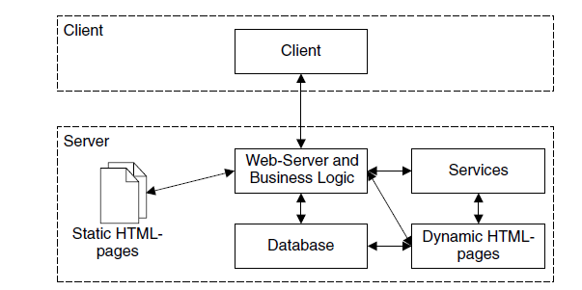
Layered Architectures
2-Layer Architectures
also called client/server architecture, uses a Web server to provide services to a client
This architecture is suitable particularly for simple Web applications.

Slide 16
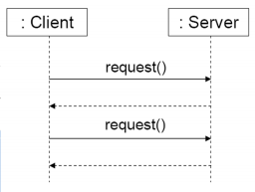
2-Layer Architectures

Slide 17
N-layer architecture
allow us to organize a Web application in an arbitrary number of layers
typically consist of three layers,
the data layer, providing access to the application data
the business layer, hosting the business logic of the application in an application server
the presentation layer, which renders the result of the request in the desired output format
2-layer and n-layer architectures differ mainly in how they embed services within the application server component.

Slide 18
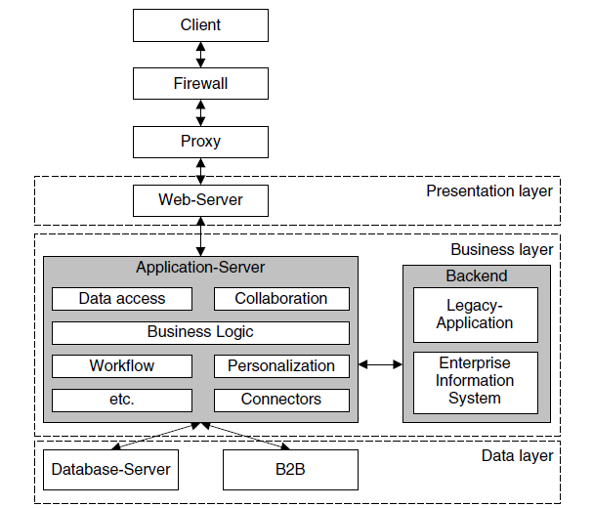
N-layer architecture

Slide 19
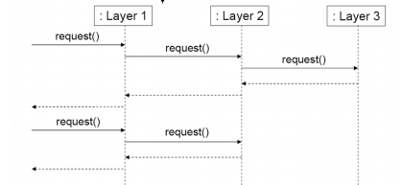
N-layer architecture

Slide 20
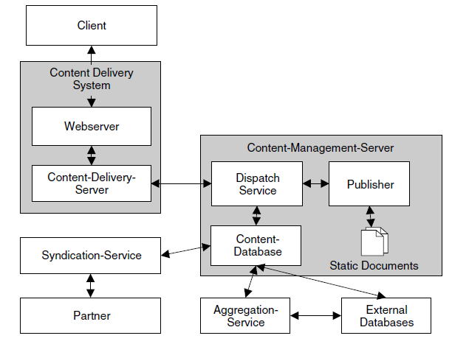
Database-centric Architectures
Architectures for Web Document Management

Slide 21
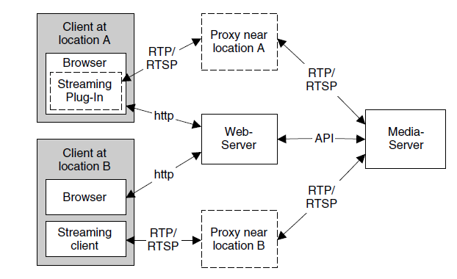
Architectures for Multimedia Data

Slide 22
Modern Web Application Architecture
SPAs
it first loads the relevant web page and then dynamically updates the representation of its content with the requested information only.
In other words, it doesn’t refer to the server for loading new pages but sends requests for the needed parts of the webpage only.
Single Page Applications contribute to smoother performance and a more intuitive user experience.

Slide 23
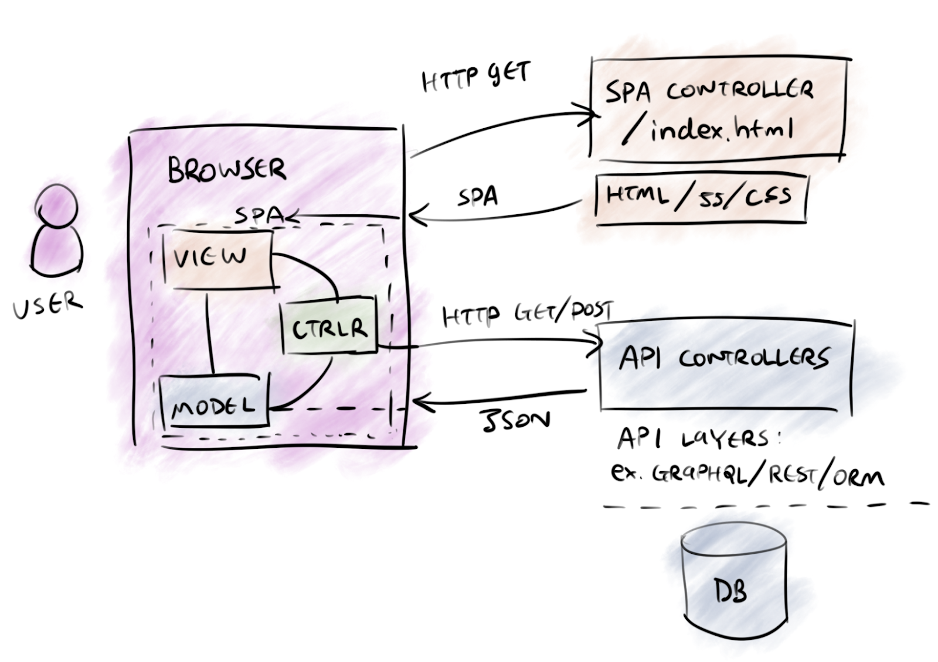
Single Page Apps- SPA

Slide 24
Microservice Architecture
Being the frequent alternative to an unreliable monolithic web application architecture, microservices disperse the functionality to deliver small and lightweight services separately.
They are loosely coupled and use APIs for communication if a sophisticated business problem arises.
Thanks to its flexibility and stability, microservice architecture has gained popularity these days, with businesses like Amazon, eBay, and Netflix adopting it for their complex needs.

Slide 25
Serverless Architecture
Outsource both server and infrastructure management to a third-party cloud service provider.
Choosing a serverless architecture is good for companies that want to delegate server and hardware management to a reliable tech partner and concentrate on front-end development tasks instead.
Also, this web application architecture type allows working on small functions in apps.
The service providers that assist in server management are Amazon and Microsoft, among others.

Slide 26
References
Web Application Architecture: The Latest Guide 2022 (clickittech.com)

